Slide 1
Digital Image Processing
Lecture # 7
Image Morphology

Slide 2
Introduction
Morphology
A branch of biology which deals with the form and structure of animals and plants
Mathematical Morphology
  A tool for extracting image components that are useful in the representation and description of region shapes
  The language of mathematical morphology is Set Theory
2
Notes:
2

Slide 3
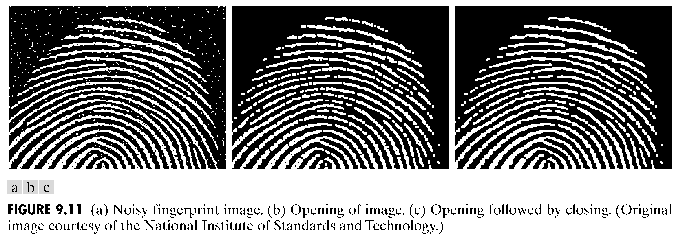
Morphology: Quick Example
Image after segmentation
Image after segmentation and morphological processing
3
Notes:
3

Slide 4
Introduction
Morphological image processing describes a range of image processing techniques that deal with the shape (or morphology) of objects in an image
Sets in mathematical morphology represents objects in an image. E.g. Set of all white pixels in a binary image.
4
Notes:
4

Slide 5
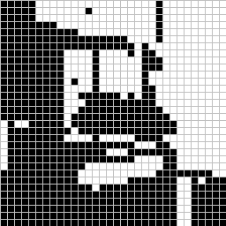
Introduction
foreground:
background
This represents a digital image. Each square is one pixel.
5
Notes:
5

Slide 6
Set Theory
The set space of binary image is Z²
  Each element of the set is a 2D vector whose coordinates are the (x,y) of a black (or white, depending on the convention) pixel in the image
The set space of gray level image is Z³
  Each element of the set is a 3D vector: (x,y) and intensity level.
NOTE:
Set Theory and Logical operations are covered in:
Section 9.1, Chapter # 9, 2nd Edition DIP by Gonzalez
Section 2.6.4, Chapter # 2, 3rd Edition DIP by Gonzalez
6
Notes:
6

Slide 7
Set Theory
Let A be a set in Z². if a = (a₁,a₂) is an element of A, then we write
If a is not an element of A, we write
Set representation
Empty or Null set
7
Notes:
7

Slide 8
Set Theory
Subset: if every element of A is also an element of another set B, the A is said to be a subset of B
Union: The set of all elements belonging either to A, B or both
Intersection: The set of all elements belonging to both A and B
8
Notes:
8

Slide 9
Set Theory
Two sets A and B are said to be disjoint or mutually exclusive if they have no common element
Complement: The set of elements not contained in A
Difference of two sets A and B, denoted by A – B, is defined as
i.e. the set of elements that belong to A, but not to B
9
Notes:
9

Slide 10
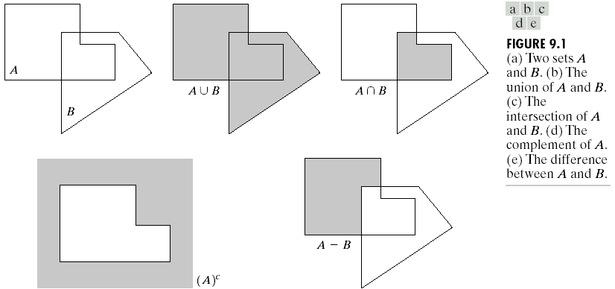
Set Theory
10
Notes:
10

Slide 11
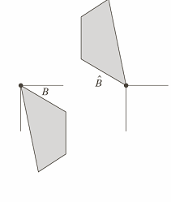
Set Theory
Reflection of set B
i.e. the set of element w, such that w is formed by multiplying each of two
coordinates of all the elements of set B by -1
11
Notes:
11

Slide 12
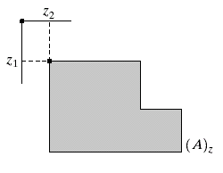
Set Theory
Translation of set A by point z = (z₁,z₂), denoted (A)_{z}, is defined as
12
Notes:
12

Slide 13
Structuring Element
A structuring element is a small image – used as a moving window
Example Structuring Elements
Structuring Elements converted to rectangular arrays
13
Notes:
13

Slide 14
Structuring Element
For simplicity we will use rectangular structuring elements with their origin at the middle pixel
0 | 0 | 1 | 0 | 0
0 | 1 | 1 | 1 | 0
1 | 1 | 1 | 1 | 1
0 | 1 | 1 | 1 | 0
0 | 0 | 1 | 0 | 0
1 | 1 | 1
1 | 1 | 1
1 | 1 | 1
0 | 1 | 0
1 | 1 | 1
0 | 1 | 0
14
Notes:
14

Slide 15
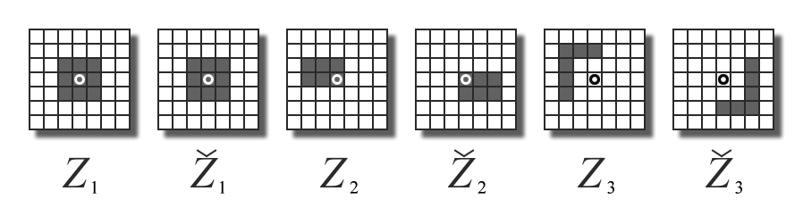
Structuring Element: Reflection
rotated by 180º around its origin.
15
Notes:
15

Slide 16
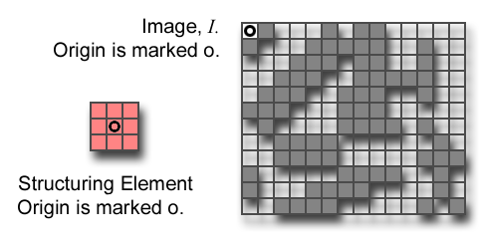
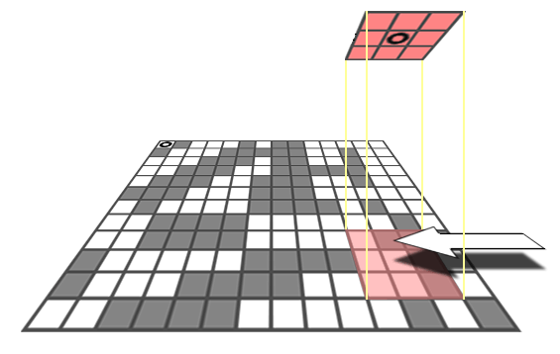
Structuring Element: Translation
Let I be an image and B a SE.
(B)_{z} means that B is moved so that its origin coincides with location z in image I.
(B)_{z} is the translate of B to location z in I.
B
z=(z₁,z₂)
16
Notes:
16

Slide 17
Structuring Elements: Hits & Fits
B
Structuring Element
Fit: All on pixels in the structuring element cover on pixels in the image
Hit: Any on pixel in the structuring element covers an on pixel in the image
A
C
All morphological processing operations are based on these simple ideas
17
Notes:
17

Slide 18
Fitting & Hitting
0 | 0 | 0 | 0 | 0 | 0 | 0 | 0 | 0 | 0 | 0 | 0
0 | 0 | 0 | 1 | 1 | 0 | 0 | 0 | 0 | 0 | 0 | 0
0 | 0 | 1 | 1 | 1 | 1 | 1 | 0 | 0 | 0 | 0 | 0
0 | 1 | 1 | 1 | 1 | 1 | 1 | 1 | 0 | 0 | 0 | 0
0 | 1 | 1 | 1 | 1 | 1 | 1 | 1 | 0 | 0 | 0 | 0
0 | 0 | 1 | 1 | 1 | 1 | 1 | 1 | 0 | 0 | 0 | 0
0 | 0 | 1 | 1 | 1 | 1 | 1 | 1 | 1 | 0 | 0 | 0
0 | 0 | 1 | 1 | 1 | 1 | 1 | 1 | 1 | 1 | 1 | 0
0 | 0 | 0 | 0 | 0 | 1 | 1 | 1 | 1 | 1 | 1 | 0
0 | 0 | 0 | 0 | 0 | 0 | 0 | 0 | 0 | 0 | 0 | 0
1 | 1 | 1
1 | 1 | 1
1 | 1 | 1
B
C
Structuring Element 1
0 | 1 | 0
1 | 1 | 1
0 | 1 | 0
A
Structuring Element 2
18
Notes:
18

Slide 19
Fundamental Operations
Fundamentally morphological image processing is very like spatial filtering
The structuring element is moved across every pixel in the original image to give a pixel in a new processed image
The value of this new pixel depends on the operation performed
There are two basic morphological operations: erosion and dilation
19
Notes:
19

Slide 20

Erosion
20
Notes:
20

Slide 21
Erosion
Definition 1:
The erosion of two sets A and B is defined as:
i.e. The Erosion of A by B is the set of all points z, such that B, translated by z, is contained in A
21
Notes:
21

Slide 22
Erosion
Definition 2:
Erosion of image f by structuring element s is given by f  s
The structuring element s is positioned with its origin at (x, y) and the new pixel value is determined using the rule:
22
Notes:
22

Slide 23
Erosion – How to compute
For each foreground pixel (which we will call the input pixel)
  Superimpose the structuring element on top of the input image so that the origin of the structuring element coincides with the input pixel position.
  If for every pixel in the structuring element, the corresponding pixel in the image underneath is a foreground pixel, then the input pixel is left as it is.
  If any of the corresponding pixels in the image are background, however, the input pixel is also set to background value.
23
Notes:
23

Slide 24
Erosion – How to compute
Erosion with a structuring element of size 3x3
24
Notes:
24

Slide 25
Erosion
B
A

Slide 26
Erosion

Slide 27
Erosion: Example
Original Image
Processed Image With Eroded Pixels
Structuring Element
27
Notes:
27

Slide 28
Erosion: Example
Original Image
Processed Image
Structuring Element
28
Notes:
28

Slide 29
Erosion
Effects
  Shrinks the size of foreground (1-valued) objects
  Smoothes object boundaries
  Removes small objects
Rule for Erosion
In a binary image, if any of the pixel (in the neighborhood defined by structuring element) is 0, then output is 0
29
Notes:
29

Slide 30

Erosion: Example 1
Original image
After erosion with a disc of radius 10
After erosion with a disc of radius 5
After erosion with a disc of radius 20
30
Notes:
30

Slide 31
Erosion: Example 2
31
Notes:
31

Slide 32

Erosion: Example 3
Original image
Erosion by 3*3 square structuring element
Erosion by 5*5 square structuring element
Note: In these examples a 1 refers to a black pixel!
32
Notes:
32

Slide 33
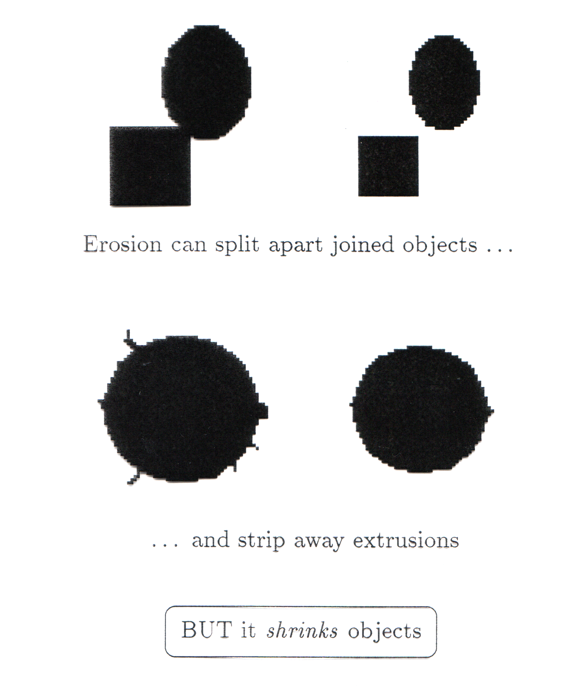
Erosion
Erosion can split apart joined objects
Erosion can strip away extrusions
Watch out: Erosion shrinks objects
33
Notes:
33

Slide 34

Exercise
Count the number of coins in the given image
34
Notes:
34

Slide 35
Exercise: Solution
Binarize the image
Perform Erosion
Use connected component labeling to count the number of coins
35
Notes:
35

Slide 36

Dilation
36
Notes:
36

Slide 37
Dilation
Definition 1:
The dilation of two sets A and B is defined as:
  i.e. when the reflection of set B about its origin is shifted by z, the dilation of A by B is the set of all displacements such that overlap A by at least one element
We will only consider symmetric SEs so reflection will have no effect
37
Notes:
37

Slide 38
Dilation
Definition 2:
Dilation of image f by structuring element s is given by
f s
The structuring element s is positioned with its origin at (x, y) and the new pixel value is determined using the rule:
38
Notes:
38

Slide 39
Dilation – How to compute
For each background pixel (which we will call the input pixel)
  Superimpose the structuring element on top of the input image so that the origin of the structuring element coincides with the input pixel position
  If at least one pixel in the structuring element coincides with a foreground pixel in the image underneath, then the input pixel is set to the foreground value
  If all the corresponding pixels in the image are background, however, the input pixel is left at the background value
39
Notes:
39

Slide 40
Dilation: Example
Effect of dilation using a 3×3 square structuring element
40
Notes:
40

Slide 41
Dilation
B
A

Slide 42
Dilation

Slide 43
Dilation: Example
Original Image
Processed Image
Structuring Element
43
Notes:
43

Slide 44
Dilation: Example
Original Image
Processed Image With Dilated Pixels
Structuring Element
44
Notes:
44

Slide 45
Dilation
Effects
  Expands the size of foreground(1-valued) objects
  Smoothes object boundaries
  Closes holes and gaps
Rule for Dilation
In a binary image, if any of the pixel (in the neighborhood defined by structuring element) is 1, then output is 1
45
Notes:
45

Slide 46

Dilation: Example 1
Original image
Dilation by 3*3 square structuring element
Dilation by 5*5 square structuring element
Note: In these examples a 1 refers to a black pixel!
46
Notes:
46

Slide 47
Dilation: Example 2
47
Notes:
47

Slide 48
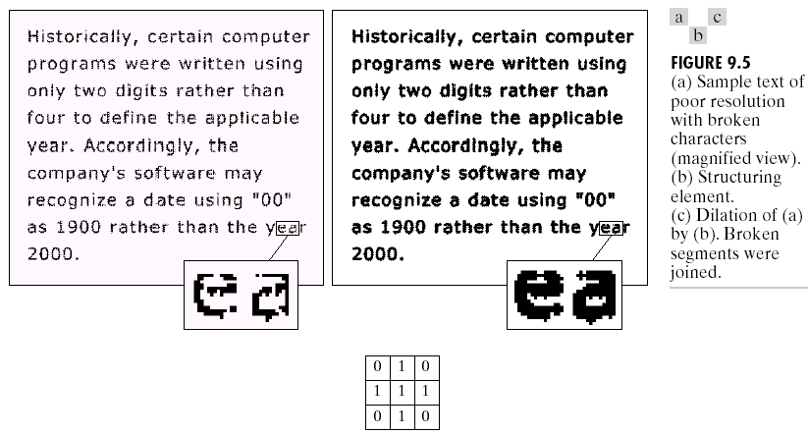
Dilation: Example 3
48
Notes:
48

Slide 49
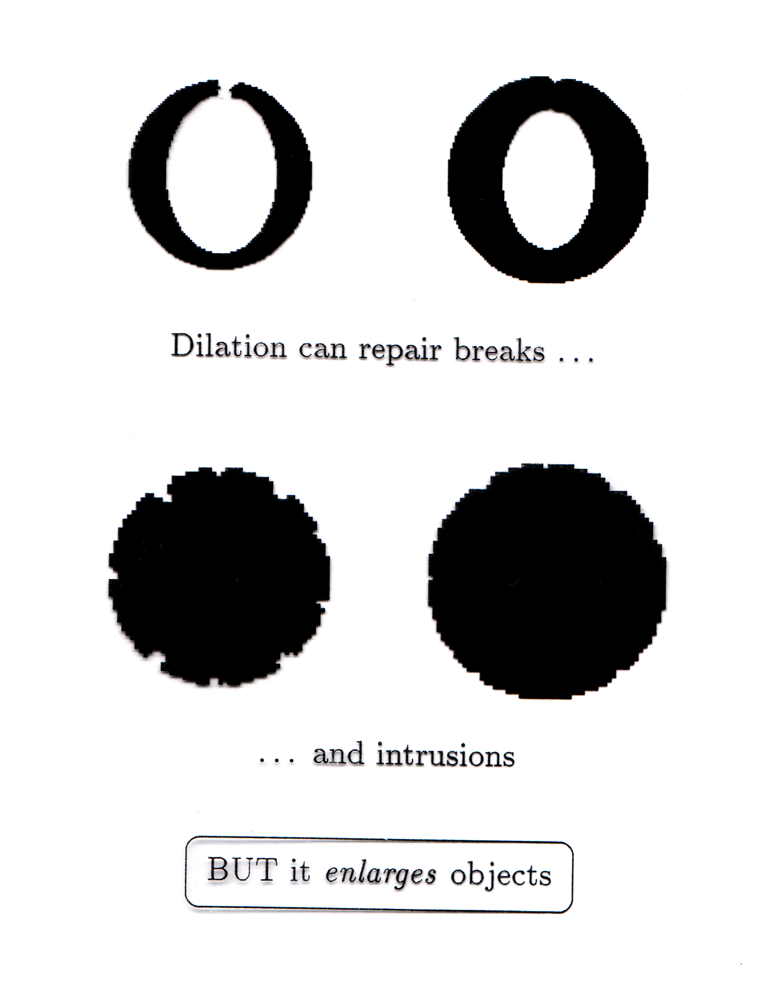
Dilation
Dilation can repair breaks
Dilation can repair intrusions
Watch out: Dilation enlarges objects
49
Notes:
49

Slide 50
Duality relationship between Dilation and Erosion
Dilation and erosion are duals of each other:
For a symmetric structuring element:
It means that we can obtain erosion of an image A by B simply by dilating its background (i.e. A^{c}) with the same structuring element and complementing the result.
50
Notes:
50

Slide 51
Compound Operations
More interesting morphological operations can be performed by performing combinations of erosions and dilations
The most widely used of these compound operations are:
  Opening
  Closing
51
Notes:
51

Slide 52
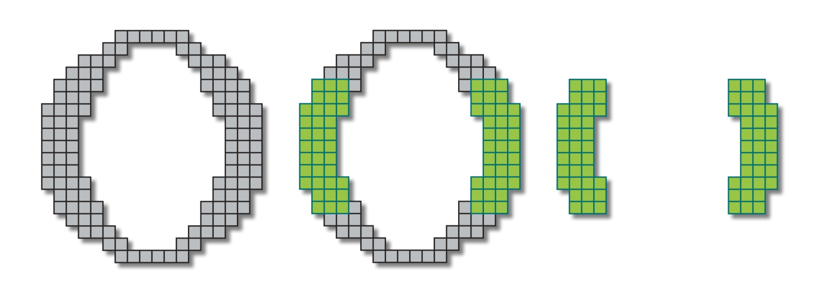
Opening
52
Notes:
52

Slide 53
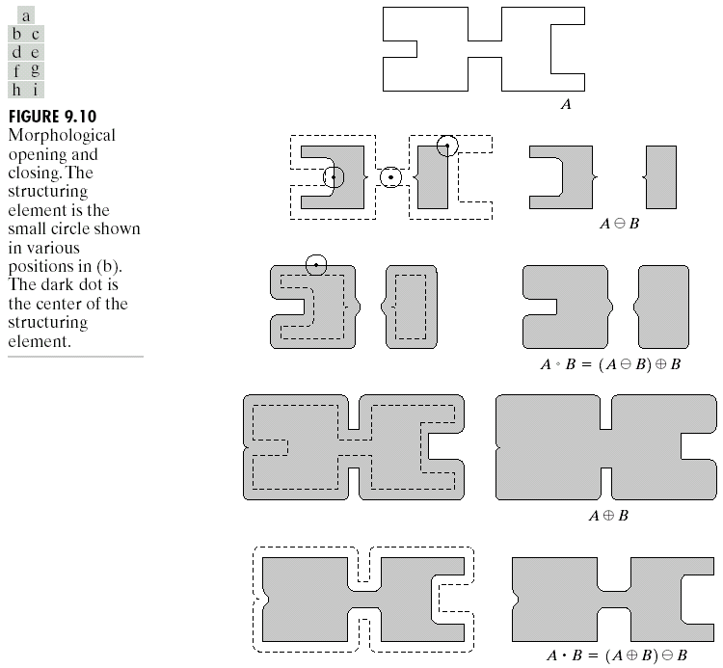
Opening
The opening of image f by structuring element s, denoted by f ○ s is simply an erosion followed by a dilation

Original shape
After erosion
After dilation
(opening)
53
Notes:
53

Slide 54

Opening: Example
Original Image
Opening
Breaks narrow joints
Removes ‘Salt’ noise
Image After Opening
54
Notes:
54

Slide 55
Opening: Example
Original Image
Processed Image
Structuring Element
55
Notes:
55

Slide 56
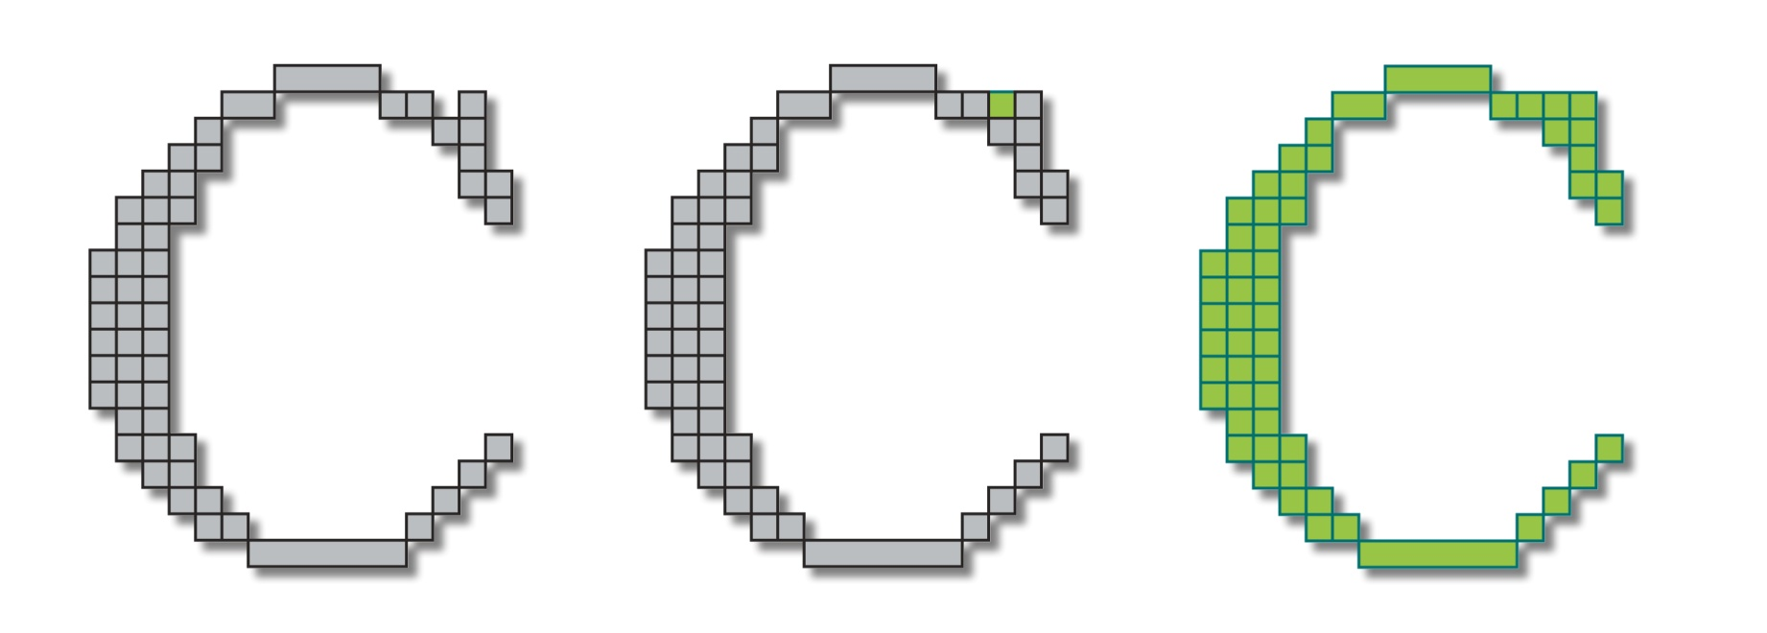
Closing
56
Notes:
56

Slide 57
Closing
The closing of image f by structuring element s, denoted by f • s is simply a dilation followed by an erosion

Original shape
After dilation
After erosion
(closing)
57
Notes:
57

Slide 58
Closing: Example
Original Image
Closing
Eliminates small holes
Fills gaps
Removes ‘Pepper’ noise
Image After Closing
58
Notes:
58

Slide 59
Closing: Example
Original Image
Processed Image
Structuring Element
59
Notes:
59

Slide 60
Closing
60
Notes:
60

Slide 61
Opening & Closing
Opening and closing are duals of each others
61
Notes:
61

Slide 62
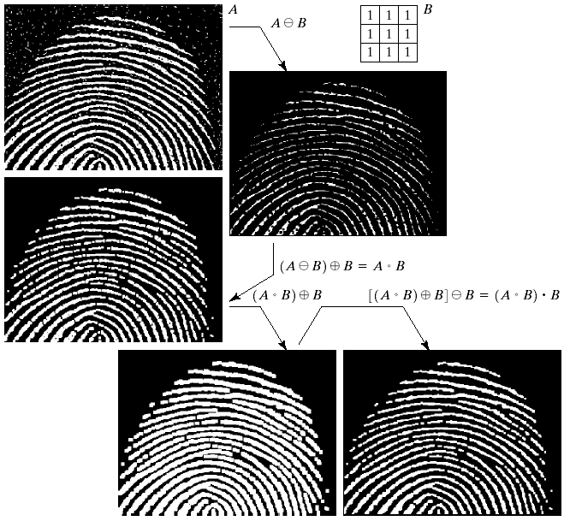

Morphological Processing Example
62
Notes:
62

Slide 63
Hit or Miss Transform

Slide 64
Hit-or-Miss Transform
A tool for shape detection or for the detection of a disjoint region in an image
Idea
  Suppose we have a binary image that contains certain shapes (circles, squares, lines, etc,….) called image A
  We use another image or matrix to search image A for a particular pattern of bits. We will call this pattern “shape B”
  We then search image A for shape B
  Whenever there is a ‘hit’, we indicate where the center of shape B was on image A.
64
Notes:
64

Slide 65
Hit-or-Miss Transform
A tool for shape detection or for the detection of a disjoint region in an image
Idea
  Suppose we have a binary image that contains certain shapes (circles, squares, lines, etc,….) called image A
  We use another image or matrix to search image A for a particular pattern of bits. We will call this pattern “shape B”
  We then search image A for shape B
  Whenever there is a ‘fit’, we indicate where the center of shape B was on image A.
Watch out: We actually look for ‘fits’ but we will be calling them ‘hits’ when talking about hit-or-miss transform
65
Notes:
65

Slide 66
Hit-or-Miss Transform
Structuring Element
So far we have considered the SEs where 0s are treated as Don’t Cares i.e. we focus on the 1s only
 | 1
1 | 1 | 1
 | 1
0 | 1 | 0
1 | 1 | 1
0 | 1 | 0
66
Notes:
66

Slide 67
Hit-or-Miss Transform
Extended Structuring Element
Now we will distinguish between the 0s and the Don’t cares
1 | 1 | 1
 | 0
 | 0
E.g. For a ‘fit’ the 0s of SE should match with 0s of the underlying image
67
Notes:
67

Slide 68
Hit-or-Miss Transform
Extended Structuring Element: Example
0 | 0 | 0 | 0 | 0 | 0 | 0 | 0
0 | 0 | 1 | 1 | 1 | 0 | 0 | 0
0 | 0 | 0 | 0 | 1 | 1 | 1 | 0
0 | 1 | 0 | 0 | 1 | 1 | 1 | 1
0 | 1 | 1 | 1 | 1 | 1 | 0 | 1
0 | 0 | 1 | 1 | 1 | 1 | 0 | 1
1
1
1
0
0
Erosion Recap: Slide the SE on the image and look for the ‘fits’
68
Notes:
68

Slide 69
Hit-or-Miss Transform
Extended Structuring Element: Example
0 | 0 | 0 | 0 | 0 | 0 | 0 | 0
0 | 0 | 1 | 1 | 1 | 0 | 0 | 0
0 | 0 | 0 | 0 | 1 | 1 | 1 | 0
0 | 1 | 0 | 0 | 1 | 1 | 1 | 1
0 | 1 | 1 | 1 | 1 | 1 | 0 | 1
0 | 0 | 1 | 1 | 1 | 1 | 0 | 1
‘Fit’ encountered
1
1
1
0
0
69
Notes:
69

Slide 70
Hit-or-Miss Transform
Extended Structuring Element: Example
0 | 0 | 0 | 0 | 0 | 0 | 0 | 0
0 | 0 | 1 | 1 | 1 | 0 | 0 | 0
0 | 0 | 0 | 0 | 1 | 1 | 1 | 0
0 | 1 | 0 | 0 | 1 | 1 | 1 | 1
0 | 1 | 1 | 1 | 1 | 1 | 0 | 1
0 | 0 | 1 | 1 | 1 | 1 | 0 | 1
1
1
1
0
0
‘Fit’ encountered
70
Notes:
70

Slide 71
Hit-or-Miss Transform
Extended Structuring Element: Example
0 | 0 | 0 | 0 | 0 | 0 | 0 | 0
0 | 0 | 1 | 1 | 1 | 0 | 0 | 0
0 | 0 | 0 | 0 | 1 | 1 | 1 | 0
0 | 1 | 0 | 0 | 1 | 1 | 1 | 1
0 | 1 | 1 | 1 | 1 | 1 | 0 | 1
0 | 0 | 1 | 1 | 1 | 1 | 0 | 1
0 | 0 | 0 | 0 | 0 | 0 | 0 | 0
0 | 0 | 0 | 0 | 0 | 0 | 0 | 0
0 | 0 | 0 | 1 | 0 | 0 | 0 | 0
0 | 0 | 0 | 0 | 0 | 0 | 0 | 0
0 | 0 | 0 | 0 | 0 | 0 | 1 | 0
0 | 0 | 0 | 0 | 0 | 0 | 0 | 0
1
1
1
0
0
What we actually did???
71
Notes:
71

Slide 72
Hit-or-Miss Transform
We have searched the pattern in the structuring element in the image
0 | 0 | 0 | 0 | 0 | 0 | 0 | 0
0 | 0 | 0 | 0 | 0 | 0 | 0 | 0
0 | 0 | 0 | 1 | 0 | 0 | 0 | 0
0 | 0 | 0 | 0 | 0 | 0 | 0 | 0
0 | 0 | 0 | 0 | 0 | 0 | 1 | 0
0 | 0 | 0 | 0 | 0 | 0 | 0 | 0
Output: The center of the pattern is 1 and rest everything is 0
72
Notes:
72

Slide 73
Hit-or-Miss Transform
Example: Search a 100x100 pixel square in an image
How do we search?
  Take an image of size 100x100 (B)
  representing a white square
  We search the pattern in the input
  image (A)
  If found, we have a “fit”. We mark
  the center of the “fit” with a
  white pixel
  In the above example, there would be only 1 fit
73
Notes:
73

Slide 74
Hit-or-Miss Transform
Do you find any problem with this?
If we search for a 100x100 pixel square in an image we will have a positive response for all squares greater than 100x100 as well
Shape / pattern
Image
The pattern will fit at different places
Need some thing here
74
Notes:
74

Slide 75
Hit-or-Miss Transform
We will limit our discussion to this simple version only
75
Notes:
75

Slide 76
Morphological Algorithms
Using the simple technique we have looked at so far we can begin to consider some more interesting morphological algorithms
We will look at:
  Boundary extraction
  Region filling
  Extraction of connected components
There are lots of others as well though:
  Thinning/thickening
  Skeletonization
76
Notes:
76

Slide 77
Boundary Extraction
The boundary of set A denoted by β(A) is obtained by first eroding A by a suitable structuring element B and then taking the difference between A and its erosion.
77
Notes:
77

Slide 78
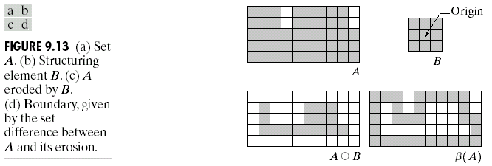
Boundary Extraction
78
Notes:
78

Slide 79
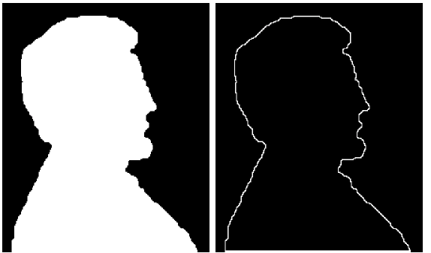
Boundary Extraction
A simple image and the result of performing boundary extraction using a square 3*3 structuring element
Original Image
Extracted Boundary
79
Notes:
79

Slide 80
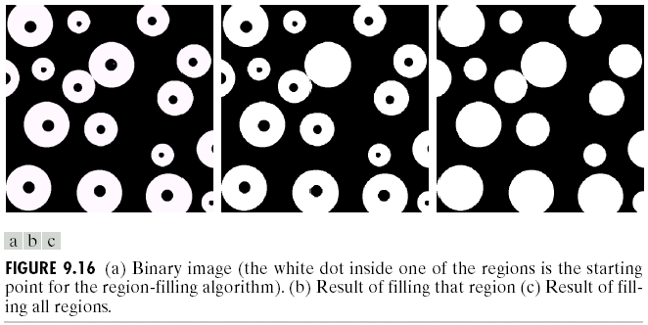
Region (hole) Filling
Given a pixel inside a boundary, region filling attempts to fill that boundary with object pixels (1s)
Given a point inside here, can we fill the whole circle?
80
Notes:
80

Slide 81
Region Filling
Let A is a set containing a subset whose elements are 8-connected boundary points of a region, enclosing a background region i.e. hole
If all boundary points are labeled 1 and non boundary points are labeled 0, the following procedure fills the region:
Start from a known point p and taking X₀= p,
Then taking the next values of X_{k} as:
B is suitable structuring element
Terminate iterations if X_{k+1} = X_{k}
The set union of X_{k} and A contains the filled set and its boundaries.
Inside the boundary
81
Notes:
81

Slide 82
Region Filling
0 | 0 | 0 | 0 | 0 | 0 | 0
0 | 1 | 1 | 1 | 1 | 1 | 0
0 | 1 | 0 | 0 | 0 | 1 | 0
0 | 1 | 0 | 0 | 0 | 1 | 0
0 | 1 | 0 | 0 | 0 | 1 | 0
0 | 1 | 1 | 1 | 1 | 1 | 0
0 | 0 | 0 | 0 | 0 | 0 | 0
1 | 1 | 1 | 1 | 1 | 1 | 1
1 | 0 | 0 | 0 | 0 | 0 | 1
1 | 0 | 1 | 1 | 1 | 0 | 1
1 | 0 | 1 | 1 | 1 | 0 | 1
1 | 0 | 1 | 1 | 1 | 0 | 1
1 | 0 | 0 | 0 | 0 | 0 | 1
1 | 1 | 1 | 1 | 1 | 1 | 1
0 | 1 | 0
1 | 1 | 1
0 | 1 | 0
B
A
A^{c}

Slide 83
Region Filling
0 | 0 | 0 | 0 | 0 | 0 | 0
0 | 0 | 0 | 0 | 0 | 0 | 0
0 | 0 | 1 | 0 | 0 | 0 | 0
0 | 0 | 0 | 0 | 0 | 0 | 0
0 | 0 | 0 | 0 | 0 | 0 | 0
0 | 0 | 0 | 0 | 0 | 0 | 0
0 | 0 | 0 | 0 | 0 | 0 | 0
0 | 0 | 0 | 0 | 0 | 0 | 0
0 | 0 | 1 | 0 | 0 | 0 | 0
0 | 1 | 1 | 1 | 0 | 0 | 0
0 | 0 | 1 | 0 | 0 | 0 | 0
0 | 0 | 0 | 0 | 0 | 0 | 0
0 | 0 | 0 | 0 | 0 | 0 | 0
0 | 0 | 0 | 0 | 0 | 0 | 0
0 | 1 | 0
1 | 1 | 1
0 | 1 | 0

Slide 84
Region Filling
0 | 0 | 0 | 0 | 0 | 0 | 0
0 | 0 | 1 | 0 | 0 | 0 | 0
0 | 1 | 1 | 1 | 0 | 0 | 0
0 | 0 | 1 | 0 | 0 | 0 | 0
0 | 0 | 0 | 0 | 0 | 0 | 0
0 | 0 | 0 | 0 | 0 | 0 | 0
0 | 0 | 0 | 0 | 0 | 0 | 0
1 | 1 | 1 | 1 | 1 | 1 | 1
1 | 0 | 0 | 0 | 0 | 0 | 1
1 | 0 | 1 | 1 | 1 | 0 | 1
1 | 0 | 1 | 1 | 1 | 0 | 1
1 | 0 | 1 | 1 | 1 | 0 | 1
1 | 0 | 0 | 0 | 0 | 0 | 1
1 | 1 | 1 | 1 | 1 | 1 | 1
0 | 0 | 0 | 0 | 0 | 0 | 0
0 | 0 | 0 | 0 | 0 | 0 | 0
0 | 0 | 1 | 1 | 0 | 0 | 0
0 | 0 | 1 | 0 | 0 | 0 | 0
0 | 0 | 0 | 0 | 0 | 0 | 0
0 | 0 | 0 | 0 | 0 | 0 | 0
0 | 0 | 0 | 0 | 0 | 0 | 0

Slide 85
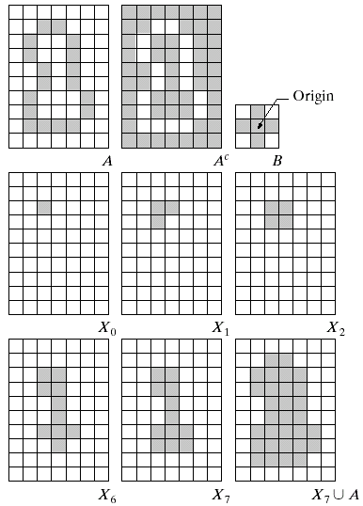
Region Filling
NOTE:
The intersection of dilation and the complement of A limits the result to inside the region of interest
85
Notes:
85

Slide 86
Region Filling: Example
Original Image
One Region Filled
All Regions Filled
86
Notes:
86

Slide 87
Extraction of Connected Components (CCs)
Let Y represents a connected component contained in A and the point p of the Y is known.
The following procedure iteratively finds all the elements of Y:
Start from a known point p and taking X₀= p,
Then taking the next values of X_{k} as:
B is a suitable structuring element
Algorithm converges if X_{k} = X_{k-1}
The component Y is given as Y = X_{k}
87
Notes:
87

Slide 88
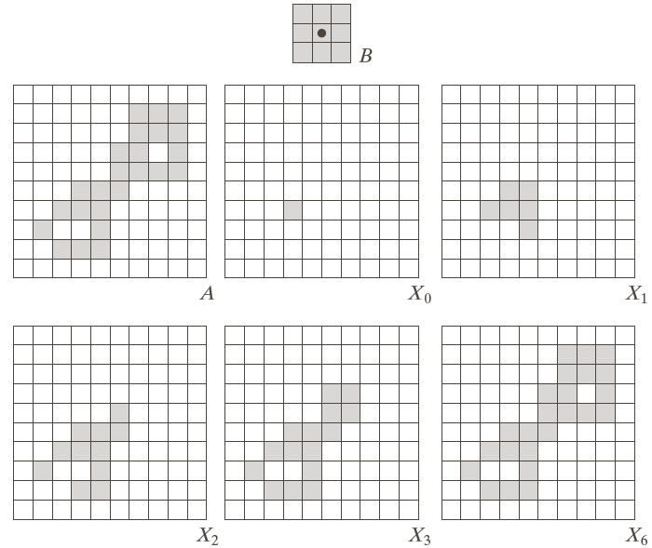
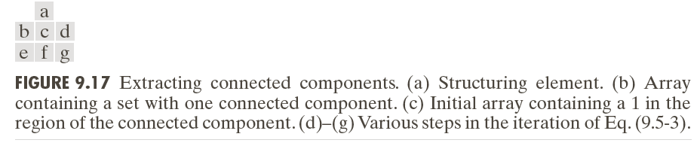
Extraction of CCs
Extraction of CCs: Example
88
Notes:
88

Slide 89

Extraction of CCs: Example
89
Notes:
89

